Slide 1

Heart Transplantation AFTER Acute Circulatory Support: PREVALENCE and OUTCOMES
David Ouyang, MD¹, Gunsagar Gulati¹, Richard Ha², Dipanjan Banerjee, MD MS¹
^{1.} Stanford University School of Medicine, DIVISION OF INTERNAL MEDICINE. ^{2.} Division of Adult Cardiac Surgery, Department of Cardiothoracic Surgery

Slide 2
Background
More patients are being bridged to cardiac transplantation with mechanical circulatory support
~40% of adult heart transplants require LVAD, RVAD, or TAH prior to transplant
Less data is available on temporary circulatory support prior to cardiac transplantation
Among status 1A waitlist candidates for heart transplantation, mortality on the waitlist ranges from 5% in those with durable mechanical circulatory support complicated by infection, to 36% in candidates supported by ECMO

Slide 3
Background
Proposed changes to the adult heart allocation system would give patients requiring support with ECMO or with temporary ventricular assist devices (PVAD) the highest priority
use of an intra-aortic balloon pump second highest priority
Patients with acute circulatory support prior to heart transplantation may have higher mortality post-transplant compared to those who do not require such support
24% mortality at 6 months in patients transplanted after ECMO
Need to balance the needs of critically ill patients on the waitlist with outcomes after transplantation

Slide 4
Hypothesis and secondary aims
Patients who undergo acute circulatory support prior to heart transplantation will exhibit significantly higher morbidity and mortality after cardiac transplantation than those patients who do not require acute circulatory support, and these outcomes will vary by type of support (ECMO vs PVAD vs IABP)
Secondary aims
Describe trends in the prevalence of acute mechanical circulatory support prior to cardiac transplantation over time
Describe changes in the outcomes after acute mechanical circulatory support prior to cardiac transplantation over time

Slide 5
METHODS
Nationwide Inpatient Sample (NIS)
largest database of all-payor inpatient discharge information, sampling approximately 20% of all non-federal US hospitals and including approximately 9 million hospital admissions each year
contains discharge data from over 5000 hospitals located across 45 states, of which approximately 1,200 hospitals are sampled each year
Each NIS entry includes all diagnosis and procedure codes of activity during the patient’s hospitalization at the time of discharge, as well as patient demographics, hospital characteristics, and short-term complications of the hospitalization

Slide 6
METHODS
We identified all patients who underwent heart transplantation in the NIS from 1988 to 2014
population was further divided by whether each patient underwent pre-transplant ECMO, PVAD, or IABP
comorbidities were identified by International Classification of Diseases 9th edition code
in-hospital complications including acute renal failure, acute respiratory failure, redo sternotomy or reoperation, sepsis, bleeding complications, stroke, liver failure, and device failure were also identified by ICD-9 code
Python 2.7 and R 2.13 were used for statistical analysis.
P-values were calculated by two-sided t-tests and Chi-squared tests, respectively, with significance thresholds of 0.05. Logistic regression was performed for the multivariate analysis.

Slide 7
RESULTS
6,892 patients from 1998 to 2014 underwent cardiac transplantation
patients were predominantly male (72.0%) and white (57.0%) and had a mean age of 46.5 years
patients had a high proportion of ischemic heart disease (42.9%), hypertension (29.7%), diabetes (19.5%), and pre-existing renal dysfunction (33.2%).
456 (6.6%) transplant recipients required acute circulatory support prior to heart transplantation
341 patients had IABP
130 patients received ECMO
21 patients underwent PVAD
increasing trend over time for the use of acute circulatory support prior to heart transplantation
17 cases per year between 1998 to 2012 to an average of 40 cases per year between 2012 to 2014

Slide 8
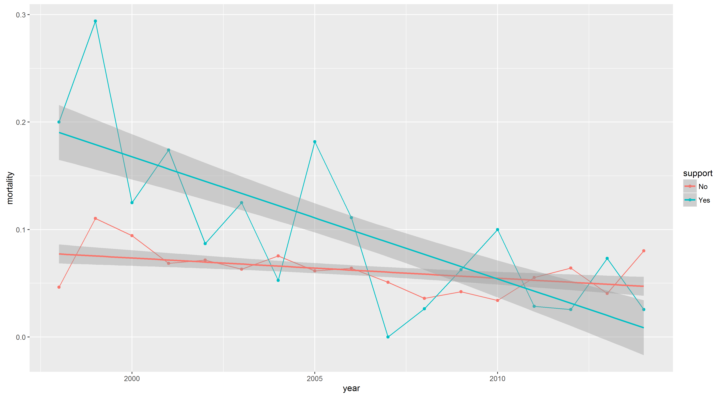
Results: mortality trend over time

Slide 9
RESULTS – Multivariate analysis of PREDICTORS OF POST TRANSPLANT mortality
 | OR | P value
Support prior to tx | 1.0003 | 0.98
Diabetes | 0.9792 | 0.04
PVD | 1.0409 | 0.19
CKD | 0.9623 | < .0001
HTN | 0.9563 | < .0001
Ischemic heart disease | 1.0086 | 0.31
Smoking | 0.9703 | 0.08
Obesity | 0.9657 | 0.13
Age By Year | 1.0005 | 0.02
Not White | 1.0082 | 0.30
Female | 1.0066 | 0.45

Slide 10
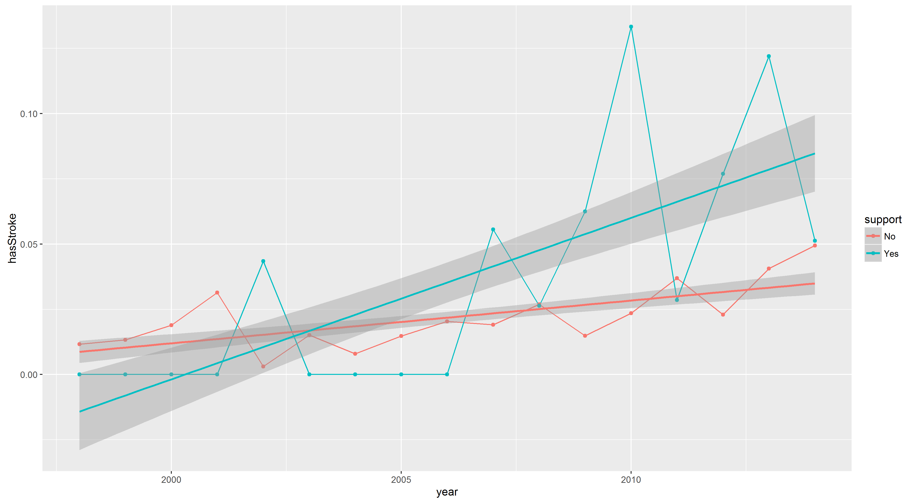
Results: STROKE trend over time

Slide 11
Results
 | 1998 - 2006 |  |  | 2007 - 2014
 | Acute Circulatory Support | None |  | Acute Circulatory Support | None
 | n = 184 | n = 3120 | p-value | n = 272 | n = 3316 | p-value
Length of stay, mean ± SD | 70.8 ± 52.4 | 43.4 ± 52.6 | < 0.001 | 68.9 ± 51.1 | 39.2 ± 45.7 | < 0.001
Mortality, n (%) | 18 (9.9) | 230 (7.4) | 0.56 | 12 (4.4) | 169 (4.8) | 0.76
Post Transplant Circulatory Support | 1 (0.6) | 29 (0.9) | 0.51 | 3 (1.1) | 59 (1.8) | 0.32
Acute Renal Failure | 78 (43.1) | 834 (26.9) | < 0.001 | 175 (64.3) | 1475 (44.5) | < 0.001
Acute Liver Failure | 12 (6.6) | 50 (1.6) | < 0.001 | 41 (15.1) | 147 (4.4) | < 0.001
Acute Respiratory Failure | 40 (22.1) | 223 (7.2) | < 0.001 | 84 (30.9) | 432 (13.0) | < 0.001
Cardiac Complications | 28 (15.5) | 365 (11.8) | 0.17 | 48 (17.6) | 451 (13.6) | 0.078
Sepsis | 8 (4.4) | 57 (1.8) | 0.03 | 44 (16.2) | 274 (8.3) | < 0.001
Stroke | 1 (0.5) | 48 (1.5) | 0.45 | 19 (7.0) | 100 (3.0) | < 0.001
Surgical Complication Requiring Reoperation | 41 (22.7) | 404 (13.0) | < 0.001 | 87 (32.0) | 578 (17.4) | < 0.001
Bleeding Complication | 60 (33.1) | 546 (17.6) | < 0.001 | 84 (30.9) | 629 (19.0) | < 0.001

Slide 12
RESULTS –POST tRANSPLANT OUTCOMES
Patients who required acute circulatory support did not exhibit significantly higher mortality post transplant than those without acute circulatory support (6.6% vs 6.2%)
the most important risk factors for mortality were presence of HTN, and CKD, followed by age and diabetes.
in hospital mortality rates declined over time in both patients who required acute circulatory support (p < 0.001 for trend) as well as patients who did not require acute circulatory support (p = 0.012 for trend)
the decline in mortality was more pronounced in patients who required acute circulatory support
Patients who required acute circulatory support had longer overall lengths of stay (70 vs. 41 days, p < 0.001)
In-hospital complications were more common in patients who required acute circulatory support
increased risk of acute renal failure (56% vs. 36.0%, p < 0.001), acute liver failure (12% vs. 3.1%, p < 0.001), acute respiratory failure (27% vs. 10%, p < 0.001), bleeding complications (32% vs. 18.%, p < 0.001), surgical complications requiring reoperation (28% vs. 15%, p < 0.001), sepsis (11% vs. 5%, p < 0.001).

Slide 13
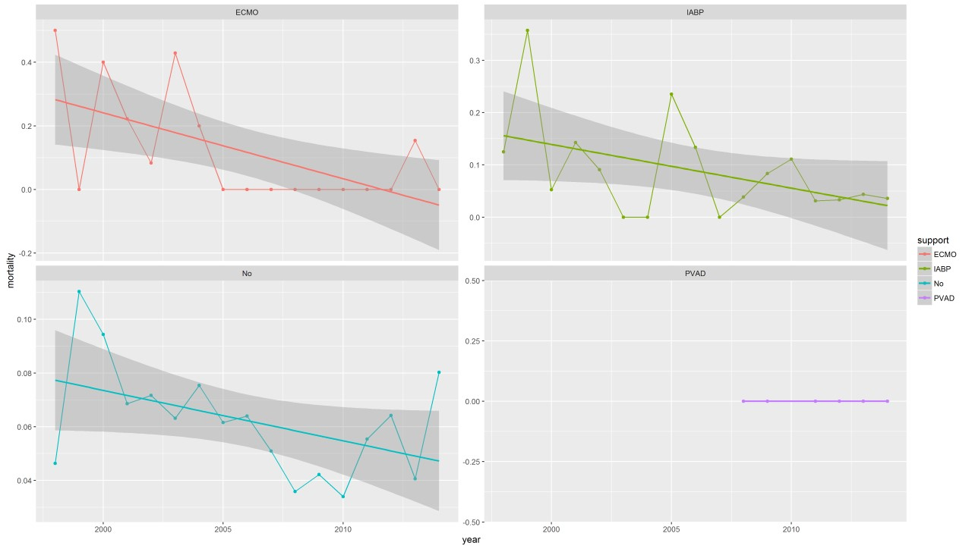
Results: MORTALITY TREND over time BY TYPE OF SUPPORT

Slide 14
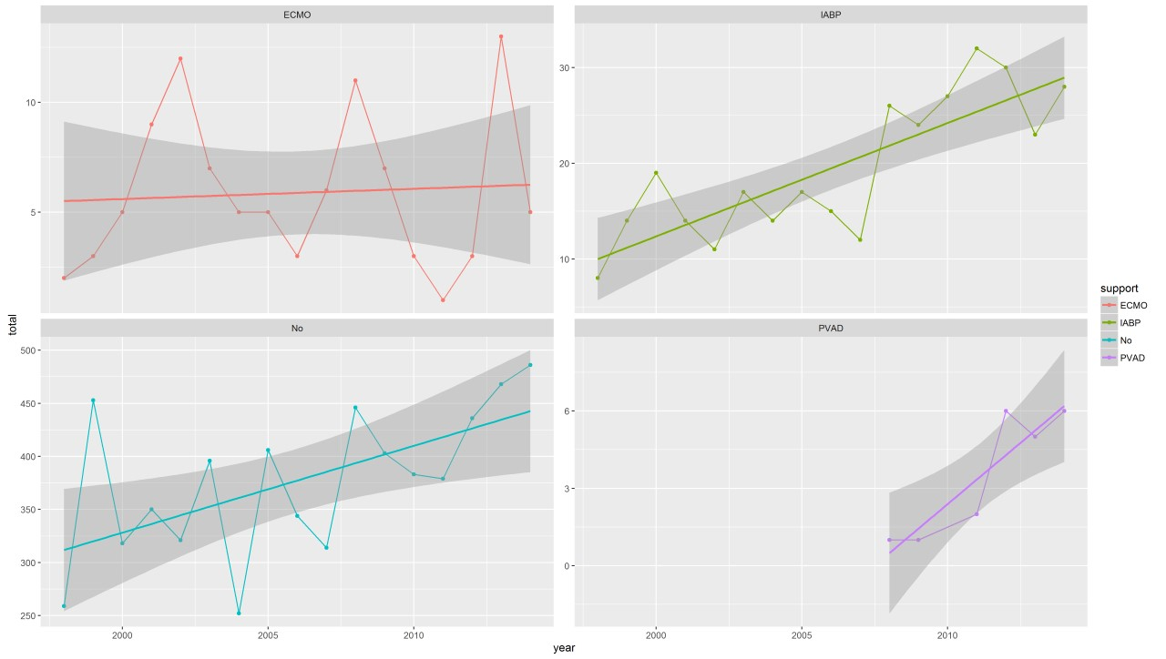
Results: TRANSPLANTS OVER TIME BY TYPE OF SUPPORT

Slide 15
DISCUSSION
Increase in use of acute circulatory support prior to heart transplantation over time
5.9% of transplants from 1998-2006 vs 8.2% from 2007-2014
Slightly higher mortality after transplant with prior acute circulatory support, but not significantly so, and improved over time
Higher rate of post transplant complications with prior use of acute circulatory support

Slide 16
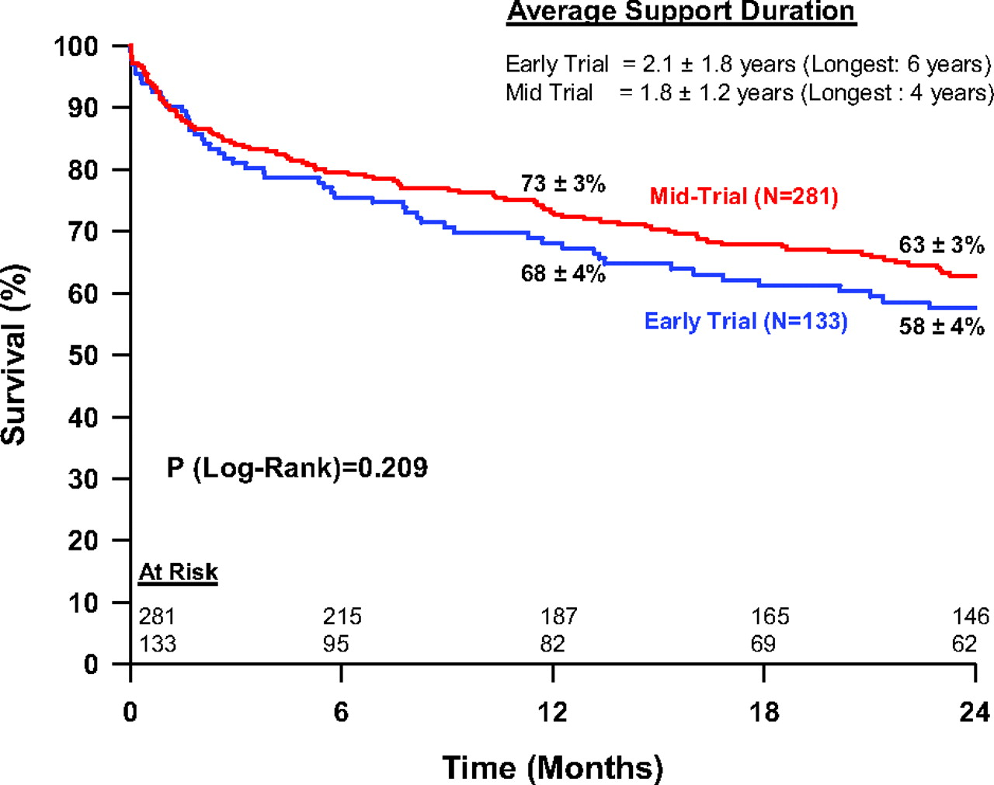

Comparison of Kaplan-Meier survival between the Early and Mid Trial groups.
Park S J et al. Circ Heart Fail. 2012;5:241-248
Copyright © American Heart Association, Inc. All rights reserved.
Notes:
Comparison of Kaplan-Meier survival between the Early and Mid Trial groups.

Slide 17
DISCUSSION
Limitations
NIS only lists same hospitalization complications and mortality, and does not have information of post-hospital follow-up
Lack of information regarding hemodynamics and end organ function at the time of transplant
Small numbers make comparisons between type of acute circulatory support and outcomes after cardiac transplantation difficult

Slide 18
CONCLUSION
Potential higher cost and morbidity with use of acute circulatory support prior to cardiac transplantation
Potential for improvement over time in these outcomes
Need for registry to serially assess outcomes
UNOS reporting for outcomes after acute circulatory support?
Centers of excellence?

